Slide 1
Drainage Area Limitations of Single Watershed, Peak Flow Estimates from NRCS Methods
Rollin H. Hotchkiss, Ph.D., P.E., BC.WRE, F.ASCE
Timothy A. Maughan, Graduate Research Assistant
Brigham Young University
Notes:
Put the BYU logo in a lower corner.

Slide 2
Acknowledgments
Nebraska Department of Transportation (NDOT)
Nebraska Department of Natural Resources (NeDNR)
United States Geological Survey (USGS)
BYU Students
Kenny Quintana
Mark Payne
Abbie Jones
Madi Pollei
Allison Kunz
Ella Post
https://twitter.com/NebraskaDOT?ref_src=twsrc%5Etfw%7Ctwcamp%5Eembeddedtimeline%7Ctwterm%5Escreen-name%3ANebraskaDOT%7Ctwcon%5Es1_c1
https://www.facebook.com/nebraskadnr/
twitter.com/USGS

Slide 3
Road Map
NRCS Methods Review
DOT Use
Purpose Statement
Literature on Drainage Area
Methodology
Nebraska Application
Results
Conclusions
https://www.arcgis.com/apps/mapviewer/index.html?layers=3b93337983e9436f8db950e38a8629af

Slide 4
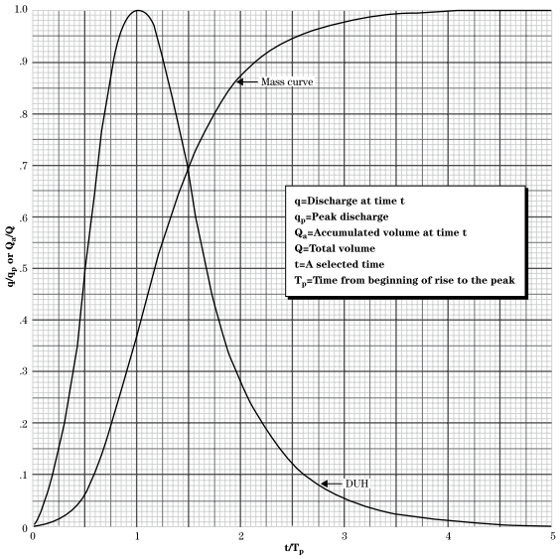
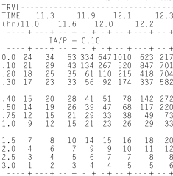
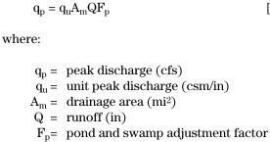
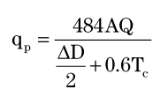
NRCS Methods
TR-20 (1964) Model implementing theory described in NEH-4 and NEH-630 [1] | TR-55 Tabular (1975) Tables that make creating a hydrograph by hand possible. Derived from TR-20 results [2] | TR-55 Graphical (1975) An empirical equation returning only peak Q. Derived from TR-20 results [2]
$$Q=\frac{{(P−0.2S)}^{2}}{P+0.8S}$$
Where P > 0.2S
Unit Discharges (csm/in) by Ia/P and Tc
Notes:
Need to show these two reference in your list.
For TR-55 tabular, replace unreadable table with a zoomed-in portion of a table that people can read.
What does the [2] and [1] refer to?

Slide 5
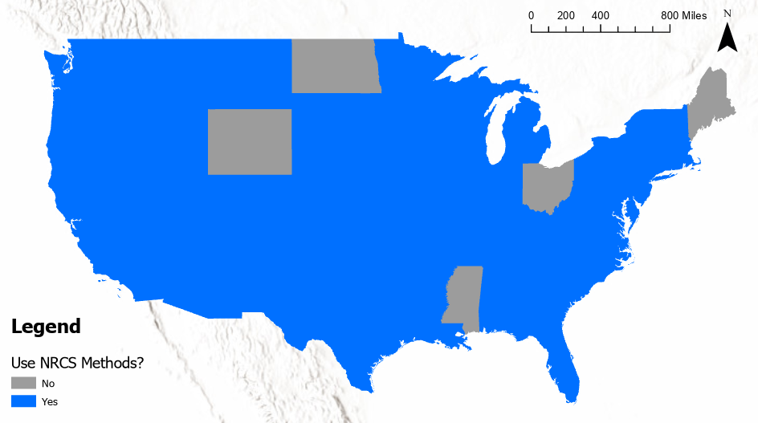
Widespread Use
45 out of 50 state DOTs use NRCS Methods
Source: State DOT Drainage Manuals
Notes:
I believe widespread is one word. Check use of apostrophe in DOT’s. Add a line source: State DOT Drainage Manuals

Slide 6
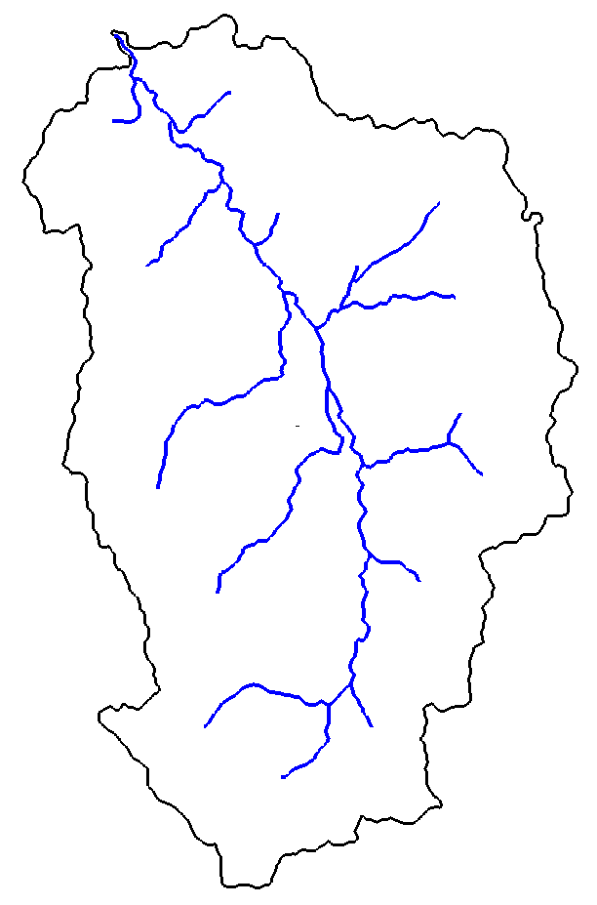
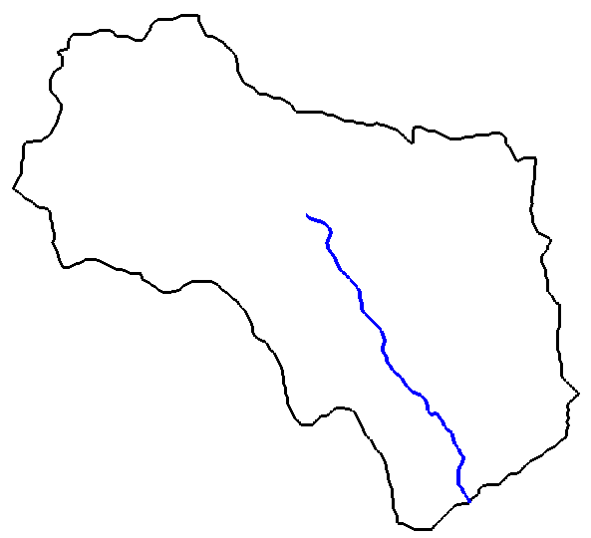
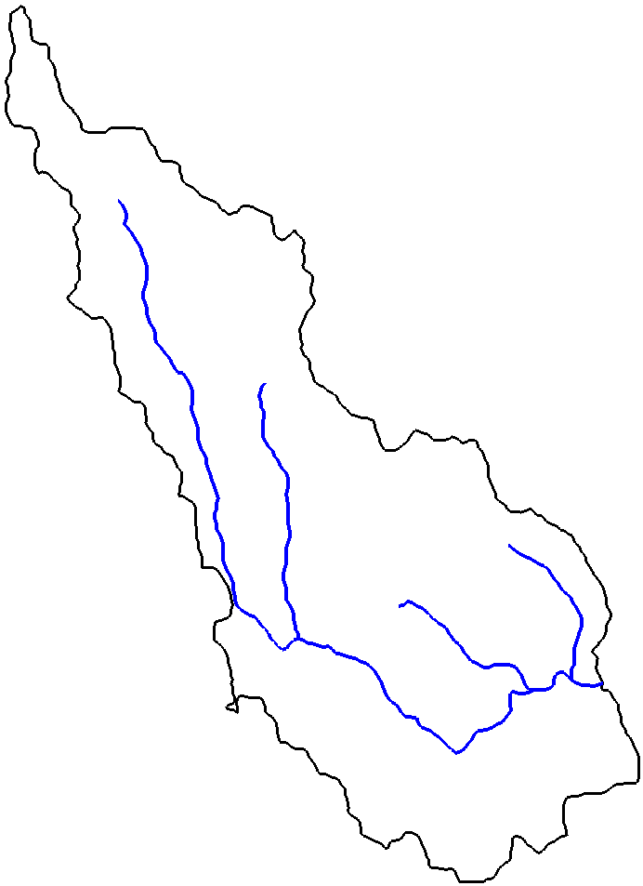
Problem: Model Selection By Drainage Area
Rational Method: 0-200 acres |  | Regression Equations: “Large Drainage Areas”
47.8 ${mi}^{2}$
0.25 ${mi}^{2}$
NRCS Methods:
Drainage Area Limitation Unknown
?
Notes:
My fault: the Rational method is used for 0-200 acres. NDOT uses it for 0-640 acres as an exception. So change it to 0-200 acres with this after: (up to 640 acres at NDOT). Instead of ?????????? For CN methods, put in Drainage Area limitation not known

Slide 7
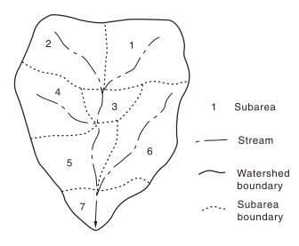
Purpose
Find a subbasin drainage area limitation for NRCS TR-20.
[2]
Notes:
Or, in other words, we are tying to answer the question for what range of non-subdivided watershed drainage areas do NRCS methods work best.
There appears to be no theoretical limit, so we, like others, will compare estimates of TR-20 peak discharges to what we consider the best available data: stream gage records

Slide 8
Drainage Area Limitations From Literature
D.A. Limitation (Units Indicated) | D.A. Limitation (mi²) | Commentary | Citation | Referencing
 | < 20 | "To assure that all contributing subareas are adequately represented, it is suggested that no subarea exceed 20 square miles in area…" | [1, 3, 4, 5] | NEH-630
0.1 to 10 mi² | 0.1 - 10 |  | [6]
5 to 100 mi² | 5 - 100 |  | [5]
100 to 5000 km² | 38.6 - 1930.5 |  | [5] | Ponce 1989, USDA SCS 1990
 |  | Small to medium drainage basins | [5] | Pilgrim and Cordery 1992
 |  | large watersheds with multiple land uses | [5] | Singh 1989
0.25 ha to 1000 km² | 0.001 - 386.1 |  | [5] | Boughton 1989
< 250 km² | < 100 |  | [7]
 |  | Perhaps no limit if uniformity assumptions are met. | [8] | Mockus
 | < 400 | The national weather service boundary between medium and large basins | [8] | The National Weather Service
 |  | Drainage area not useful for selecting a method for estimating discharge | [4]
 | 1 – 10 | For cultivated agricultural land | [9]
Most Authoritative Source Yet No Study Supporting Limitation…

Slide 9
Early Conclusions
No official NRCS stance on whether the Lag or Segmental method should be paired with TR-20
WinTR-55 Makes hydrographs the same way TR-20 does, using NEH-630 methods, not TR-55 methods.

Slide 10
Models
Flow frequency at stream gages using Bulletin 17C
TR-20 (Lag & Segmental)
Regression Equations
The National Water Model
GEOGloWS
Compare Model Predictions to Flow Frequency Predictions!
Why are we testing other Methods?
Model
Output
Inputs
Notes:
All peak flow predictions will be compared to flow frequency peak flow predictions obtained using Bulletin 17C procedures.
Key elements of the Bulletin 17C procedures include the EMA expected Moments Algorithm and a Log-Pearson Type III extreme value distribution
Try to make the legend legible. If you can’t, then delete the legend. Don’t show anything that the audience cannot read.
You’ll need a few slides to explain the national water model.

Slide 11
Methodology
Only comparing Segmental TR-20 and Lag TR-20 in this presentation
Bulletin 17C
“True” Peak Flows
Gage Data
Regression Peak Flows
Regression
Site Data
Segmental & Lag Peak Flows
TR-20
USGS Gage Locations
Compare
Simulated Gage Data From National Water Model
Bulletin 17C
NWM Peak Flows
GEOGloWS Peak Flows
Bulletin 17C
Simulated Gage Data From GEOGloWS
Model Selection Decision Tree by DA

Slide 12
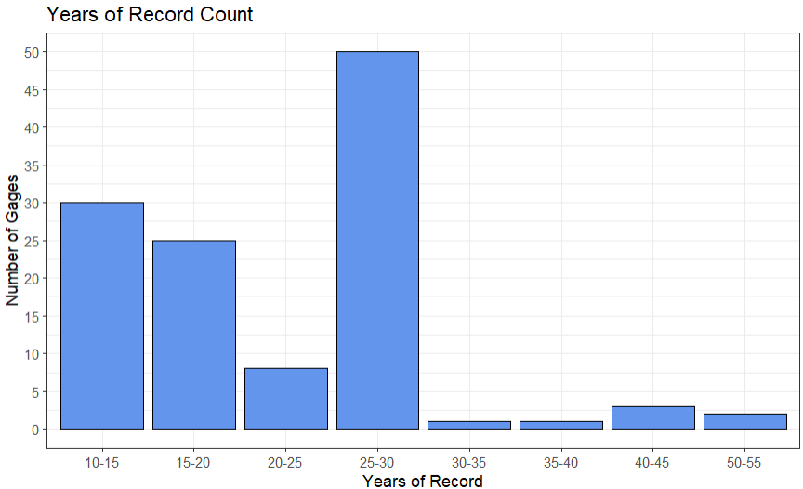
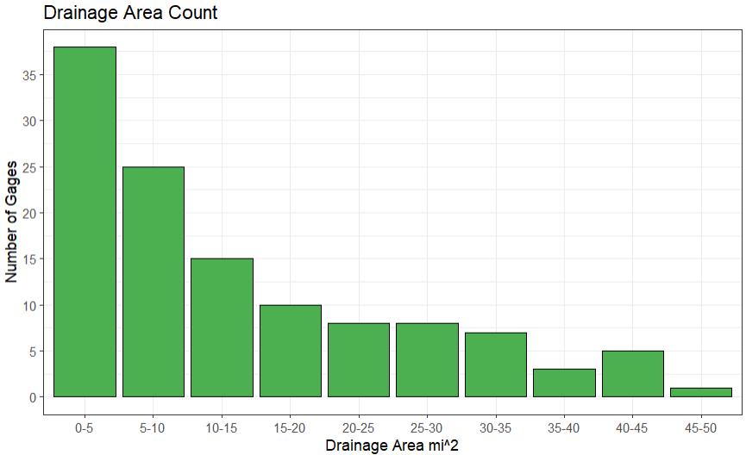
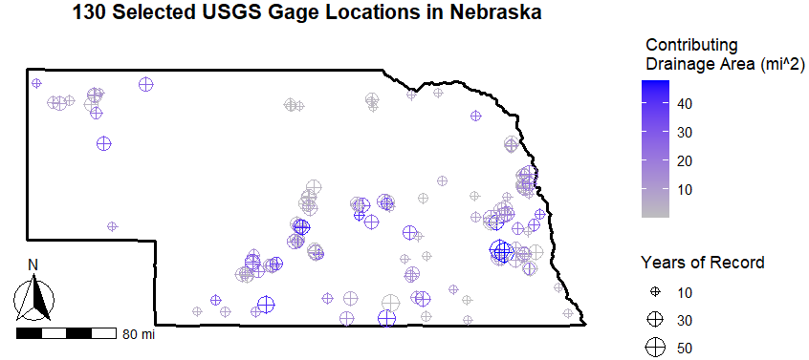
Apply to Nebraska
Selected 130 USGS gages in Nebraska with DA < 50 mi² and greater than 10 years of record
Only used gages with more than 25 years of record for 50- and 100-year return periods

Slide 13
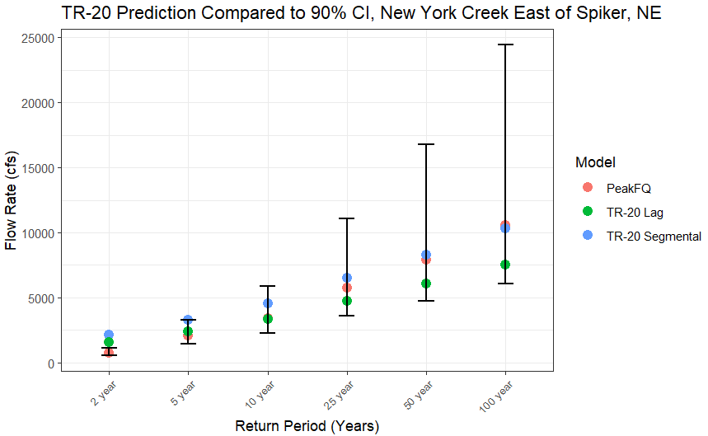
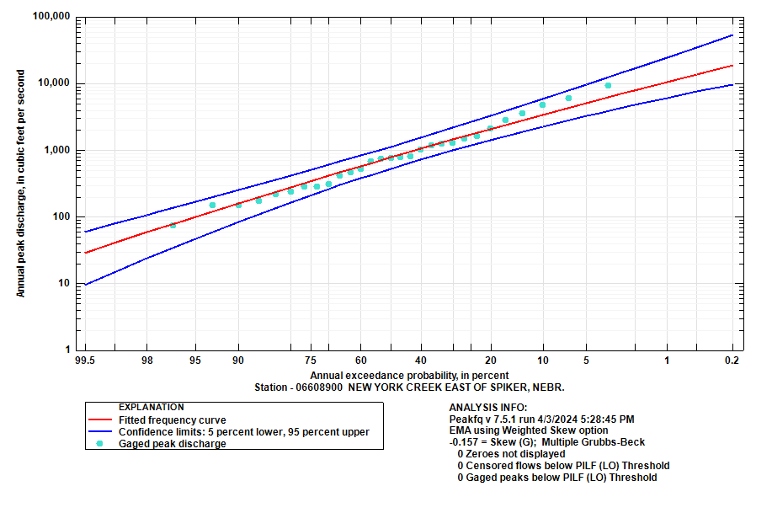
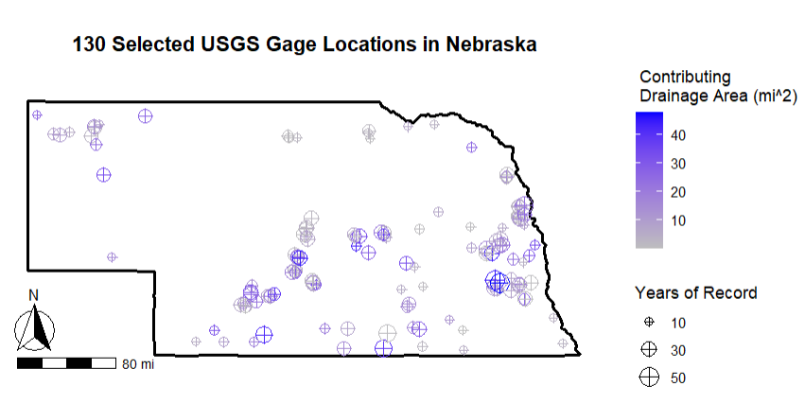
Comparison #1

Slide 14
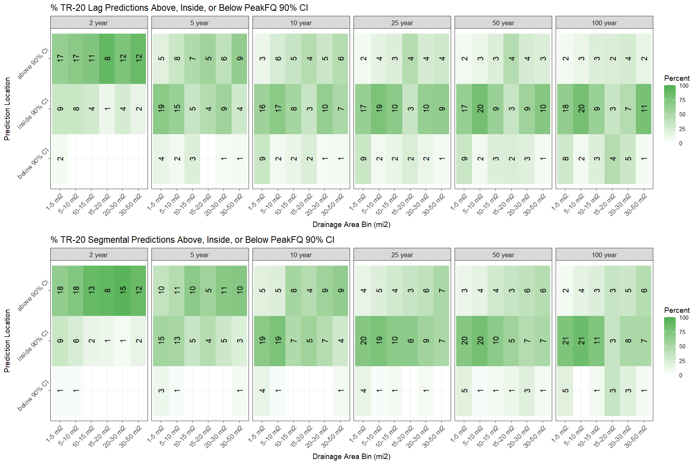
1-50 mi² Lag vs Segmental
15 mi²

Slide 15
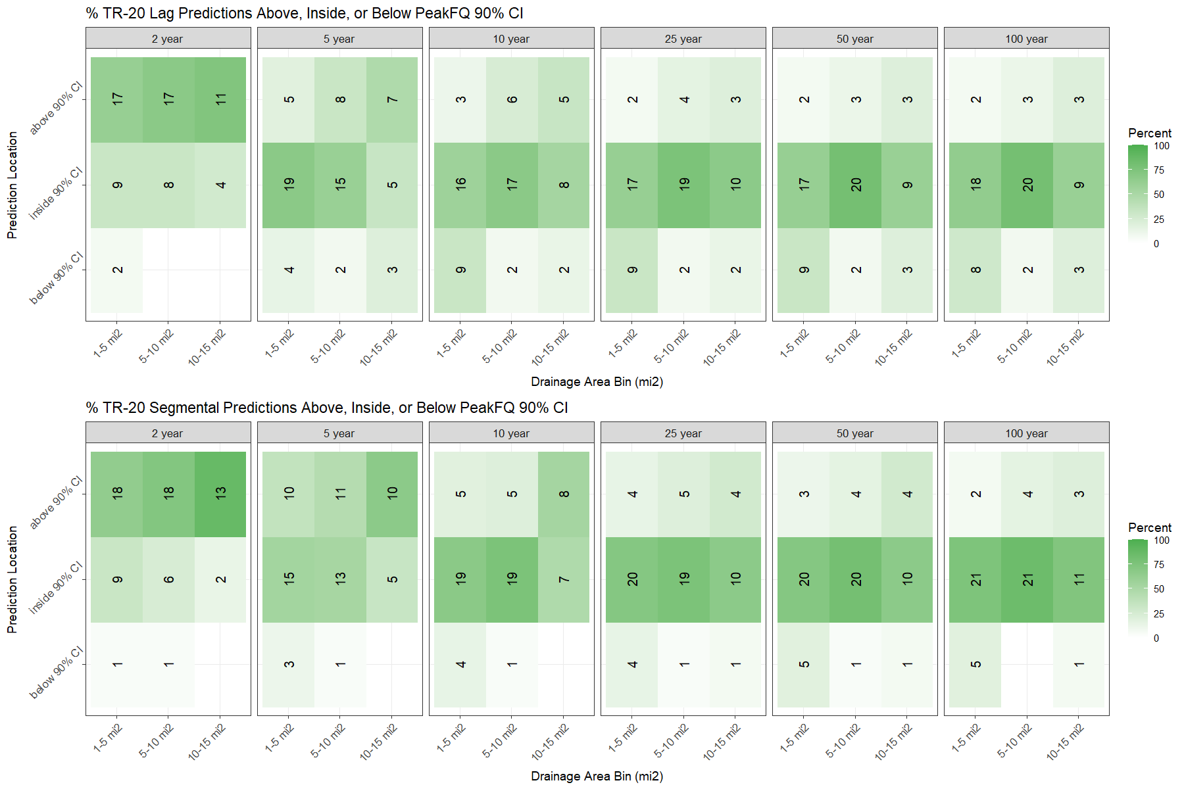
1-15 mi² Lag vs Segmental

Slide 16
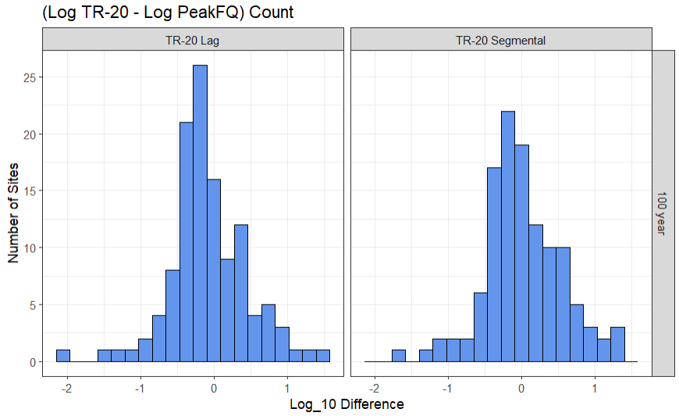
Comparison #2, Bland/Altman Plots
Also Called Difference Plots
Usable under assumption of normally distributed differences
Slightly Negative Skewed

Slide 17
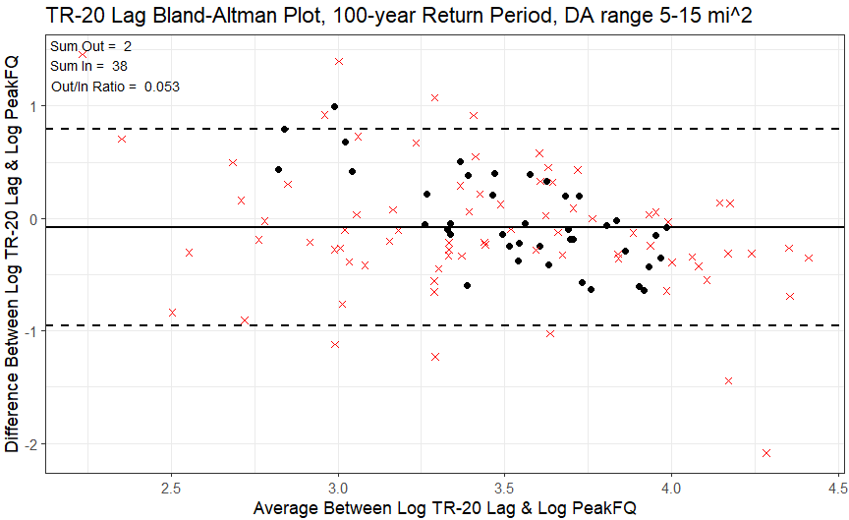
Comparison #2
Test DA range
1 indicates TR-20 Peak is 10 times larger than PeakFQ peak
Lowest In/Out ratio is best
Upper 90% confidence interval
Mean
Lower 90% confidence interval
-2 indicates TR-20 peak is 100 times smaller than PeakFQ peak
Black points are in DA range
Red x’s are not in DA range
Plot average to spread data horizontally

Slide 18
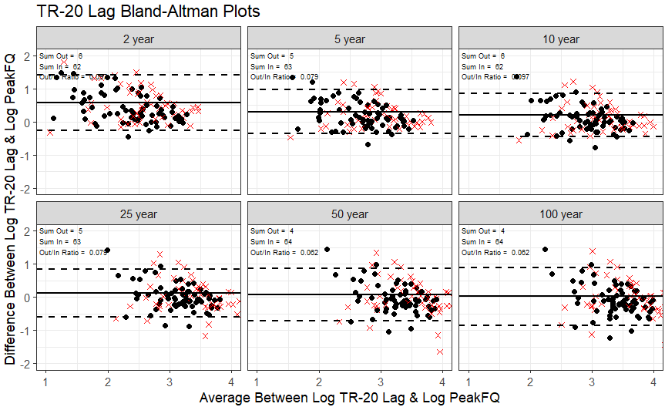
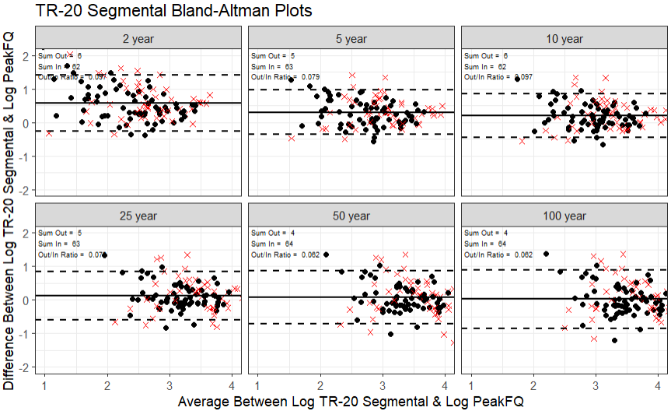
TR-20 Lag, 1-15 mi², (In/Out) Range = 0.062-0.097

Slide 19
TR-20 Segmental, 1-15 mi², (In/Out) Range = 0.062-0.097

Slide 20
Early Conclusions
Potential 15 mi² drainage area limitation for TR-20
Visual inspection indicates that perhaps the segmental method performs better than lag method.
Lag method shows more consistency
Segmental method generally has shorter T_{c} and higher peak Q

Slide 21
Future Work
Compare Regression, National Water Model, and GEOGloWS. See if they outperform TR-20.
Seek new statistical methods for explaining our data

Slide 22
References
Soil Conservation Service, S., National engineering handbook, section 4, hydrology. 1972, US Department of Agriculture Washington, DC.
Agriculture, U.S.D.o., Urban Hydrology for Small Watersheds, in Technical Release 55. 1986, United States Department of Agriculture.
McCuen, R.H., A guide to hydrologic analysis using SCS methods. 1982: Prentice-Hall, Inc.
Thompson, D., Literature review for TxDOT project 0–4405: Scale issues in hydrology. 2004, TxDOT Report 0–4405–1, TechMRT, Texas Tech University, Lubbock, Texas 79409: Springfield, VA. p. 1-105.
Hawkins, R.H., et al., Curve Number Hydrology: State of the Practice. 2008.
Haan, C.T., H.P. Johnson, and D.L. Brakensiek, Hydrologic modeling of small watersheds. 1982.
Mishra, S.K. and V.P. Singh, Soil Conservation Service Curve Number (SCS-CN) Methodology. 2013: Springer Netherlands.
Ponce, V.M., CN Oral History Victor Miguel Ponce, in Zoom, G. Moglen, Editor. 2021, Glenn Moglen: YouTube.
Transportation, N.D.o., Drainage and Erosion Control Manual. 2018, Nebraska Department of Transportation. p. (1-24)-(1-37).
NOAA. NOAA National Water Model CONUS Retrospective Dataset. [cited 2024 April 3rd]; Available from: https://registry.opendata.aws/nwm-archive/.
https://water.noaa.gov/about/nwm

Slide 23
TR-20 Parameters
Input | Sources | Problems
Land Use Data | Download online land use data Manually digitize | Land use descriptions and CN descriptions are rarely exact matches. Troublesome when weighting a CN.
Time of Concentration | Lag Method Segmental Method | Both produce significantly different T_{c} values. TR-55 requires Segmental Method, but which method is appropriate for TR-20? [2]
Open Channel Flow Length for Natural Channels | Satellite Imagery Topo Maps | Flow length based on user judgment.
Sheet Flow Length | Literature | NEH-630 says typically < 100ft TR-55 says 300ft maximum Which one to use? [1,2]
Open Channel Flow Manning’s n | Literature/Drainage Manuals | Subjective selection based on user
Cross-sectional Area for Hydraulic Radius | Extract from Elevation Raster Assume trapezoidal channel | Nearly all available elevation data does not penetrate the water surface. Also, where should we cut the cross-section?

Slide 24
0-5 Square Miles Lag vs Segmental

Slide 25
5-10 mi² Lag vs Segmental

Slide 26
10-15 mi² Lag vs Segmental

